Slide 1

By Steve Hartmann, Mohamed Dek Hussein, & Touko Lee

Slide 2

Overview
History & Vendors - Steve
CPU Architecture - Steve
CPU Memory Management – Mohamed
Sample Program - Touko
ISA Architecture - Touko

Slide 3

History & Vendors

Slide 4
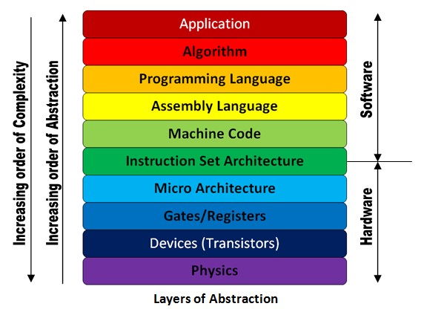
What is ISA?
Instruction Set Architecture
Central component of the processor​
Acts as an interface between the hardware and the software
Specifies what the processor can do as well as how it gets done

Slide 5
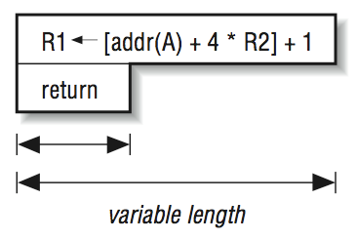
What is CISC?
Complex Instruction Set Computer​
Legacy approach for microprocessor architecture design
Goal was to complete a task in as few lines of assembly code as possible
Single program instruction used to do all loading, evaluating and storing operations​

Slide 6
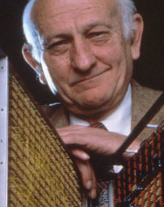
The RISC Concept
Reduced Instruction Set Computer
Developed from discovery most processor instructions are unused by most programs
Main idea is don't add complexity unless it pays for itself by how frequently you use it
Research led by John Cocke and team at IBM in late 1970s, with IBM 801 the first computer prototype

Slide 7
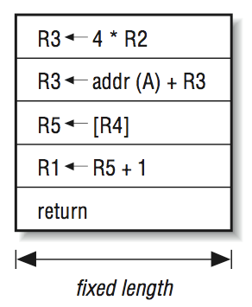
RISC Essentials
CISC implementations of complex operations tend to be slower than a sequence of simpler operations doing the same thing​
Separate program instruction used to do individual loading, evaluating, and storing operations​
Larger number of program instructions but smaller number of clock cycles per instruction​

Slide 8
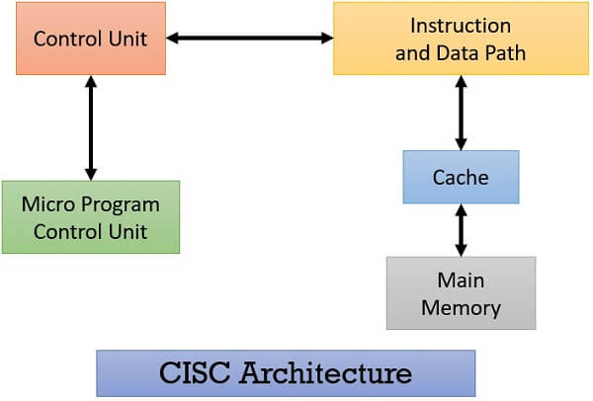
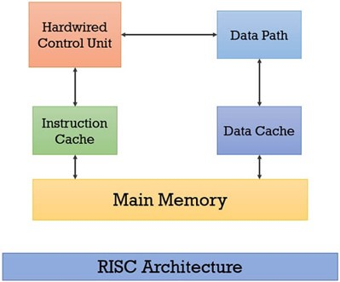

Slide 9
CISC vs RISC Summary
Complex Instruction Set Computer | Reduced Instruction Set Computer
Emphasis on hardware and heavy use of stack | Emphasis on software and heavy use of registers
Large number of instructions | Small number of instructions
Complex, variable-length instructions | Simple, fixed-length instructions
Instructions can take several clock cycles | Instructions all take single clock cycle
Small program code size | Large program code size

Slide 10
What is RISC-V?
RISC-V ("Risk-Five") is the latest generation of RISC processors
Started in 2010 at University of California, Berkely (UCB) as part of Parallel Computing Laboratory (Par Lab)
Development led by professors Krste Asanovic and David Patterson with graduate students Yunsup Lee and Andrew Waterman

Slide 11
Why the Name?
Naming scheme comes from David Patterson at UC Berkely (Berkely RISC)
Although it has five in the name, not actually connected to previous generation RISC processors
RISC-I and RISC-II were designed in 1981 with ISA changes
RISC-III (SOAR) designed in 1984 and converted to run Smalltalk
RISC-IV (SPUR) designed in 1988 and was a Lisp machine

Slide 12
Why use RISC-V?
The RISC-V ISA is a common, free, open-standard specification provided under open-source licensing that allows community access and collaboration
RISC-V is developed by the RISC-V International organization with 500+ members including Intel, Samsung, and Nvidia
Membership is free to join and there is no single company controlling things behind the scenes

Slide 13
Who's using RISC-V?
Qualcomm shipped a total of 650 million RISC-V cores
Andes and Codasip are each at over 2 billion RISC-V cores shipped
Western Digital ships over a billion RISC-V cores a year
Apple is converting some non-user-facing systems to RISC-V
Google announced that Android now works on RISC-V

Slide 14
Hardware Vendors
Ventana​
SiFive​
Tenstorrent​
Rivos​
Codasip​​
Alibaba
XMOS
Krakatoa
Imagination
Western Digital
Andes
MIPS

Slide 15

Ventana has Veyron family of high-performance RISC-V processors
Veyron V1 is the powerhouse as one of the highest performance RISC-V processors available today
Features include eight stage pipelining, 3.6GHz speed, and 16 cores per cluster
High core count multi-cluster scalability, up to 128 cores and 48MB of shared L3 cache per cluster

Slide 16

Western Digital has the SweRV Core family of RISC-V cores available
The SweRV Core EH1 is a 32-bit, 2-way superscalar, 9 stage pipeline core that offers compelling capabilities for embedded devices supporting data-intensive edge applications, such as storage controllers, industrial IoT, and real-time analytics in surveillance systems
The SweRV Core EH2 was the first commercial RISC-V core and it offered dual threaded capability while notching an impressive CoreMarks score of 7.8 in dual threaded mode

Slide 17

SiFive was founded by the inventors of RISC-V
SiFive Core IP portfolio is comprised of four distinct families spanning from high-performance application processors to area-optimized, low-power embedded 32- and 64-bit microcontrollers
SiFive Essential™, SiFive Performance™, SiFive Intelligence™, and SiFive Automotive™ families are tailored to the specific needs for each industry including safety, security, and resiliency

Slide 18

RISC-V CPU Architecture
Cores
Hyperthreading
Caching

Slide 19
RISC-V Cores
The RISC-V machine-level ISA contains a common core that is extended depending on which other privilege levels are supported and other details of the hardware implementation
The system-level organization of a RISC-V hardware platform can range from a single-core microcontroller to a many-thousand-node cluster of shared-memory manycore server nodes
A RISC-V hardware platform can contain one or more RISC-V-compatible processing cores together with other non-RISC-V-compatible cores

Slide 20
RISC-V Hyperthreading
The base RISC-V ISA supports multiple concurrent threads of execution within a single user address space
Each RISC-V hardware thread (hart) has its own user register state and program counter, and executes an independent sequential instruction stream
RISC-V harts can communicate and synchronize with other harts either via calls to the execution environment, or directly via the shared memory system
RISC-V harts can also interact with I/O devices, and indirectly with each other, via loads and stores to portions of the address space assigned to I/O

Slide 21
RISC-V Hart Levels
At any time, a hart is running at some privilege level and the current privilege level is encoded in one or more control and status registers (CSRs)
The RISC-V specification defines four privilege levels, where each level provides its own protection and isolation
The highest privilege level is the machine level, and it has access to and can alter the whole machine
The lowest level is the user/application level, and it is used to protect the rest of the system from malicious applications
Supervisor level is used to provide isolation between the operating system and the machine and user levels
Hypervisor level is used to virtualize the operating system

Slide 22
RISC-V Caching
RISC-V does not define a cache coherence policy, and doesn't even mandate that all memory is coherent
The ISA does have some defined behavior that restricts the set of coherence schemes that may be reasonable to choose when implementing RISC-V, but there isn't much set in stone
The RISC-V architecture does not define specific cache configurations but provides the flexibility for CPU designers to incorporate caching mechanisms according to their requirements

Slide 23
RISC-V Common Cache Types
Cache Type | Description
Instruction Cache (I-cache) | Stores frequently accessed instructions, reducing the instruction fetch latency
Data Cache (D-cache) | Holds frequently accessed data, reducing the need to access main memory for load/store operations
Unified Cache (Optional) | Instruction and data caches combined into single unified cache, which can be more efficient in terms of space utilization
L1/L2 Cache (L1/L2) | Sit closest to the processor core and provide fast access to data and instructions

Slide 24
Sources
https://www.riscv.org
https://riscv.org/technical/specifications/
https://riscv.org/technical/specifications/risc-v-genealogy/
https://en.wikipedia.org/wiki/Berkeley_RISC
https://en.wikipedia.org/wiki/Reduced_instruction_set_computer
https://www.ibm.com/ibm/history/ibm100/us/en/icons/risc/
https://www.per-international.com/news-and-insights/risc-vs-cisc-architecture-which-is-better
https://www.semianalysis.com/p/ventana-risc-v-cpus-beating-next
Essentials of Computer Organization and Architecture (Linda Null, Julia Lobur)

Slide 26
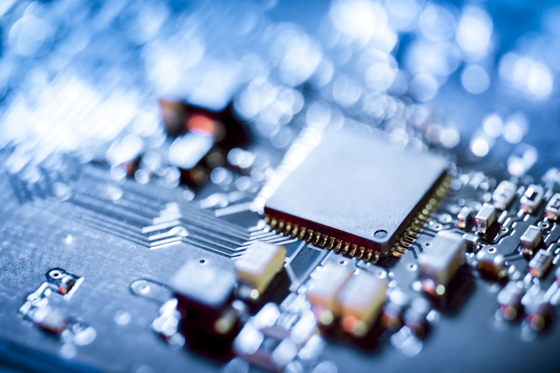
RISC-V CPU MEMORY MANAGEMENT
Mohamed Dek Hussein

Slide 27

Overview of Memory Management in RISC-V Processors
RISC-V processors employ a memory management system that enables efficient memory usage and protects the integrity of the system.
The memory management architecture consists of two important components: paging and virtual memory.
Paging and virtual memory work together to provide a seamless and flexible memory abstraction to software applications.

Slide 28

Paging in RISC-V Processors
Paging is a memory management technique that divides physical memory into fixed-sized blocks called pages.
RISC-V processors use a two-level paging scheme, instead of having a single level of page tables ,consisting of a top-level page table and second-level page tables. The two-level paging scheme in RISC-V processors helps in optimizing memory access.
The top-level page table contains entries that point to the second-level page tables, which, in turn, map virtual addresses to physical addresses. This hierarchical structure allows for efficient memory lookups by dividing the virtual address space into smaller chunks. Each entry in the top-level page table corresponds to a range of virtual addresses.
When a virtual address needs to be translated to a physical address, the processor uses the virtual address's higher-order bits to index into the top-level page table. The corresponding entry in the top-level page table points to the second-level page table that contains the translation for the lower-order bits of the virtual address. By using this two-level structure, the processor narrows down the search space for the translation, reducing the overhead of page table lookups.

Slide 29
Paging continued…
Paging is key mechanism that enables virtual memory implementations. Physical RAM is divided into equal-sized pages, often 4 kilobytes in size. The available virtual address space, which is much larger than physical memory, is similarly divided into pages of the same size.
The page table data structure contains the mappings between each virtual page and the corresponding physical page frame in RAM where it is located. If a program accesses a virtual page that is not currently mapped in RAM, called a page fault, the operating system handles bringing that page from disk and mapping it into a free physical page frame.
This allows programs to use a virtual address space that is larger than what could fit in physical RAM alone. The Translation Lookaside Buffer caches the most recent virtual to physical page translations to avoid having to look up every single mapping in the page table. This helps accelerate the paging and memory access process.
When physical memory starts filling up, less frequently used pages can be evicted or swapped out to disk to make room, using a page replacement algorithm.
When swapped out, the mapping for that virtual page is marked invalid and will cause a page fault if accessed again. Overall, paging provides an extremely flexible memory management architecture, leveraging disk storage to create a virtual memory system larger than physical RAM.

Slide 30
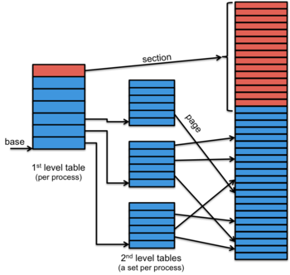

Slide 31
Page Tables
Page tables are hierarchical data structures that contain the complete mappings from virtual addresses to physical addresses. This multi-level page table organization allows the table to scale across large virtual address spaces while fitting in memory.
For the x86 architecture, four levels of page tables are utilized. The top level page table contains 1024 entries and each entry points to a second level table. Each second level entry points to a third level table, and each third level entry finally points to the fourth level page frame address.
This four level structure uses 9 bits for the first index, 9 bits for second index, 9 bits for third index, and 12 bits for the final frame offset. So a 32 bit virtual address is divided into these four portions to traverse the hierarchical page table and arrive at the physical frame mapping.
The total translation process involves walking down through these multi-level page table structures which takes multiple memory accesses. To accelerate this process, the Translation Lookaside Buffer caches the most frequently or recently used page table entries so the mappings can be determined without a full table walk. I’ll talk more about TLB later in this presentation

Slide 32
Virtual Memory in RISC-V Processors
Virtual memory is a technique that provides an illusion of vast memory resources to software applications.
RISC-V processors support virtual memory by allowing the translation of virtual addresses to physical addresses.
Each process in RISC-V has its own virtual address space, which is independent of the underlying physical memory.
Virtual memory provides several benefits, including memory protection, efficient memory allocation, and sharing of memory resources.

Slide 33

What are the benefits of Virtual Memory?
Virtual memory in RISC-V processors provides several important benefits:
Enabling larger address spaces than physical memory: Virtual memory allows each process to have its own virtual address space, which can be larger than the available physical memory. This feature enables software applications to work with more extensive datasets and address a larger memory space than what is physically present.
Facilitating memory sharing among processes: Virtual memory allows multiple processes to share the same physical memory pages. This feature is especially useful in scenarios where multiple processes need access to the same data or code. By sharing memory, processes can avoid unnecessary duplication, reducing memory usage and improving overall system efficiency.
Simplifying programming by providing a consistent memory model: Virtual memory provides a consistent memory model for software applications. Regardless of the physical memory layout, each process perceives its own private virtual address space. This abstraction simplifies programming by allowing software developers to work with a consistent memory model, without worrying about the specifics of physical memory organization or fragmentation.

Slide 34
Memory Protection in RISC-V Processors
Memory protection is a critical aspect of CPU memory management in RISC-V processors. It ensures that each process can only access the memory regions it is authorized to and prevents unauthorized access. The Memory Management Unit (MMU) is responsible for enforcing memory protection.
The MMU checks the access rights for each memory access made by a process. These access rights include permissions such as read, write, and execute. When a memory access is requested, the MMU verifies that the access is within the authorized permissions for the corresponding virtual memory page. If the access violates the permissions or attempts to access memory outside the allocated space, the MMU raises a memory protection exception, halting the process and preventing any unauthorized access.
Memory protection is crucial for system security and stability. It ensures that processes cannot interfere with each other's memory or access sensitive system areas. By isolating processes and enforcing access control, memory protection enhances system reliability and security.

Slide 35

Translation Lookaside Buffer (TLB)

Slide 36
TLB
The Translation Lookaside Buffer, or TLB, is a critical performance optimization component for virtual memory and paging architectures. The TLB serves as a small, fast cache memory that holds the most recent translations from virtual memory addresses to physical memory addresses.
It typically contains 64 to 256 address translation entries. The TLB acts as a cache for the page table walk process. If a requested virtual address translation is contained in the TLB, called a TLB hit, the corresponding physical address can be retrieved immediately without having to traverse through the page table structures in memory.
This enables much faster virtual address to physical address resolution as long as translations can be satisfied from the TLB. If a translation is not contained in the TLB, called a TLB miss, it must be retrieved via a full page table walk, which adds substantial latency to the memory access.
Therefore, TLB reach and lookup speed is critical for good system performance. The percentage of translations that can be satisfied from the TLB is known as the TLB hit rate. The higher the hit rate, the less page walks are needed. Optimizing and pre-filling the TLB is important to achieve high hit rates and fast address translation.

Slide 37
More on how the TLB works as a cache
The Translation Lookaside Buffer (TLB) is a hardware cache that plays a vital role in speeding up the address translation process in RISC-V processors. The TLB stores recently used virtual-to-physical address translations, avoiding the need for a complete page table lookup for each memory access.
When a memory access occurs, the processor first checks if the virtual-to-physical address translation is present in the TLB. If the translation is found, the TLB provides the corresponding physical address directly, eliminating the need to traverse the page table hierarchy.
The TLB acts as a cache for these translations because it stores a limited number of recently used translations. It utilizes the principle of locality of memory accesses, where addresses that are accessed close in time are likely to be accessed again in the near future. By caching frequently used translations, the TLB significantly reduces the latency and overhead of the address translation process, improving memory access performance.
The TLB is typically implemented as a set-associative or fully-associative cache, providing fast access to translations. However, if a translation is not found in the TLB (a TLB miss), the processor resorts to the standard page table lookup mechanism to retrieve the translation and updates the TLB accordingly.
Overall, the TLB plays a crucial role in reducing memory access times, especially for frequently accessed memory locations, and contributes to the overall performance improvement of RISC-V processors.

Slide 38
Address Translation Process
Let's walk through the address translation process in RISC-V processors.
When a virtual address is generated by a program, it undergoes a two-stage translation process: virtual to physical address translation.
The MMU uses the page table hierarchy to locate the physical address corresponding to the virtual address.
This translation process occurs transparently to the software, allowing efficient memory access while maintaining memory protection.

Slide 39

Benefits of Paging and Virtual Memory in RISC-V Processors
Paging and virtual memory offer several advantages in RISC-V processors:
Memory protection: Isolates processes and prevents unauthorized access.
Efficient memory utilization: Enables larger address spaces than physical memory.
Memory sharing: Facilitates sharing of memory resources among multiple processes.
Flexibility: Allows dynamic allocation and deallocation of memory as needed.
Simplified programming: Provides a consistent memory model to software applications.

Slide 40
More on Paging benefits
Paging and virtual memory provide several major benefits for computer system design, flexibility, memory utilization and program execution.
First, paging allows virtual address spaces to be much larger than the available physical memory. Programs operate in a clean virtual address realm independently from the physical memory size.
Second, paging makes it easy to context switch between multiple processes or applications - each process operates in its own isolated virtual address space.
Third, paging enables memory protection controls by allowing access restrictions to be set on individual pages. This prevents processes from accidentally or intentionally overwriting memory they shouldn't have access to.
Fourth, less utilized pages can be efficiently swapped out to disk when physical memory fills up. This provides essentially unlimited virtual memory capacity.
Lastly, the overall virtual memory architecture enabled by paging provides extremely flexible, protected and efficient memory management. Programs are allocated as much virtual memory as they need. The operating system and MMU handles mapping this to available physical resources efficiently.

Slide 41
Paging Challenges
However, there are also several notable challenges introduced by paging architectures:
First, page faults incur high overhead when a non-resident page must be fetched from disk. The page fault will likely require an I/O operation and interrupt, adding substantial latency. If page faults occur frequently, system performance degrades.
Second, TLB reach and speed is extremely critical for performance. Larger TLBs with high hit rates minimize exposure to page walks.
Third, the operating system must implement intelligent page replacement algorithms when swapping pages to disk. Suboptimal replacement policies can lead to excessive page faults.
Finally, the baseline address translation latency through either the TLB or page walk adds overhead to every memory access. So while paging enables many benefits, it also poses performance and complexity challenges that must be managed carefully in both hardware and OS design.

Slide 42
Conclusion
The CPU's memory management architecture enables flexible and efficient virtual memory systems through the use of paging. Paging provides hardware and OS mechanisms to map segmented virtual addresses to physical memory, allowing programs to operate in large virtual address spaces independent of actual RAM constraints.
The Memory Management Unit and specialized CPU hardware accelerate address translations by walking multi-level page tables and caching mappings in a fast TLB translation cache. Together, these components allow transparent remapping of virtual pages to physical frames by the operating system.
Paging facilitates critical capabilities including overcommitment of memory, easy process switching, and fine-grained memory protection controls. Virtual memory spaces can be swapped to disk as needed, providing virtually unlimited address capacity.
However, paging also introduces challenges like handling page faults and optimizing page replacement algorithms. TLB performance is critical to avoid expensive page walks. The tradeoffs and overheads introduced require careful hardware and OS design considerations.
In summary, leveraging paging techniques in the CPU memory management unit enables flexible virtual memory architectures, providing programs with abundant, protected address spaces. Paging forms the foundation for efficient multi-tasking systems despite limited physical memory. The virtualization and abstraction paging enables is a cornerstone of modern computing systems.

Slide 44
Instruction Set Architecture
Instruction Formats
Registers in RISC-V Processor
Sample Instructions in RISC-V Processor
Stack Management in RISC-V Processor
Optimization
Without Optimization
Benefits of RISC-V Processor
Challenges of RISC-V Processor
Future of RISC-V Processor

Slide 45



Instruction Set Architecture
The instruction set architecture (ISA) of RISC-V processor is designed to be simple and modular, making it easy to implement in hardware and software.
The ISA includes 32 registers, each 32 bits wide, which can be used for storing data and addresses. In addition, there are several special-purpose registers, such as the program counter (PC), stack pointer (SP), and status register (SR), which are used for controlling program flow and managing system resources.
RISC-V processor uses a load-store architecture
Sample instructions in RISC-V processor include arithmetic and logical operations, control flow instructions, and memory access instructions.
Stack management in RISC-V processor is handled through the use of the SP register, which points to the top of the stack

Slide 46
Instruction Format
R-Type
I-Type
S-Type
B-Type
U-Type
J-Type

Slide 47
Registers in RISC-V Processor
RISC-V processor has a set of registers that are used to store data temporarily during the execution of instructions.
The integer registers are used for general-purpose operations
the floating-point registers are used for floating-point operations
The control registers are used to manage exceptions, interrupts, and privileged operations.
RISC-V also has special purpose registers such as program counter (PC), stack pointer (SP), and link register (LR).

Slide 48
Sample Instructions in RISC-V Processor
RISC-V processor has a set of sample instructions that are used to perform various operations.
Ex: Arithmetic, logic, memory access, and control transfer instructions.
Memory access instructions include load and store operations.
Control transfer instructions include branch and jump operations.
The RISC-V instruction set is designed to be easy to decode, which makes it efficient for pipelined execution.

Slide 49
Stack Management in RISC-V Processor
The stack is a region of memory used to store data temporarily during program execution.
The stack pointer register (sp) points to the top of the stack and is updated as items are pushed onto or popped off of the stack.
Importance of stack management

Slide 50
Compilation with Optimization
Compiling a C program with optimization for the RISC-V processor involves using a compiler that is specifically designed for this architecture.
Ex. GCC
These options include -O1, -O2, and -O3, which correspond to different levels of optimization.

Slide 51
Compilation of C Program without Optimization
Compiling a C program for the RISC-V processor without optimization involves several steps:
-First the compiler reads the source code and generates an assembly file.
-Next, the assembler converts the assembly file into machine code
-Finally, the linker combines the machine code with any necessary libraries to create an executable file that can be run on the RISC-V processor.
Potential issue: executable may not be as efficient as it could be.

Slide 52
Benefits of RISC-V Processor
Open Source
Modular design
Simple and efficient
Lower Power consumption

Slide 53
Challenges of RISC-V Processor
Lack of widespread adoption
Lack of standardization

Slide 54
Future of RISC-V Processor
Its open-source nature and growing community
Its customizable architecture allows for flexibility and adaptability, making it ideal for a wide range of applications.
Its low power consumption and high performance
Additionally, as more companies adopt RISC-V processor, we can expect to see a decrease in licensing fees and an increase in innovation.

Slide 55
Summary
History & Vendors – Steve
CPU Architecture – Steve
CPU Memory Management – Mohamed
ISA Architecture – Touko
Sample Program – Touko

Slide 56
References
1. Waterman, A., Lee, Y., Patterson, D., Asanovic, K., & Fox, A. (2017). The RISC-V Instruction Set Manual Volume I: User-Level ISA Version 2.2. Retrieved from https://riscv.org/specifications/
2. RISC-V Foundation. (2021). About the RISC-V Foundation. Retrieved from https://riscv.org/about/
3. Shafique, M., Henkel, J., & Parameswaran, S. (2018). RISC-V Based Processor for IoT Applications: Opportunities and Challenges. In Internet of Things From Hype to Reality (pp. 45-60). Springer, Cham.
4. Singh, S., Garg, V., & Sharma, S. (2021). An Overview of RISC-V Architecture and Its Advantages. International Journal of Computer Sciences and Engineering, 9(3), 141-147.
5. Kim, J., & Lee, J. (2019). Design of a RISC-V Processor for Edge Computing. IEEE Access, 7, 123206-123214.
6. Li, P., Liu, X., & Wang, L. (2018). RISC-V Based Machine Learning Accelerator Design. In 2018 IEEE International Conference on Computational Science and Engineering (CSE) (pp. 1210-1213). IEEE.

